Slide 1

Computer Graphics OpenGL project:- Road Horizon(car racing)

Slide 2
Overview:-
Our Project is Computer Graphics based car racing game. The objective of this game is to survive as long as possible and get to the High scores while avoiding the obstacles on the tracks.

Slide 3
Description:-
The game is created in openGL and Code Blocks.
⊳ The User will play the game to achieve highest score.
⊳ The user can select the playing mode according to its choice whether he/she wants to play in medium mode or in hard mode.
⊳ Although the game automatically increases speed of obstacles(car), every time when the score is greater than 50(i.e. Level up).
⊳ On collision with any of the obstacles the scores will stop.
⊳ On collision, the user will have two choices.
⊳ According to his choice, either the user can restart the game or user can end it.

Slide 4
Functions:-
Details of three important functions:-
glutDisplayFunc(display):- In this function our first screen and start game window are call accordingly when user wants to play the game.
glutSpecialFunc(spe_key):- In this function we have set Top, Bottom, Up,Down keys tasks.
glutKeyboardFunc(processKeys):- In process key we are again set all the variable values, so the game could run as the number of times user wants.

Slide 5
Features:-
User can select the speed of obstacles, whether user wants to play the game at high speed or low speed.
The obstacles are not coming randomly, they are coming with respect to the position of user car this make our game much harder.

Slide 6
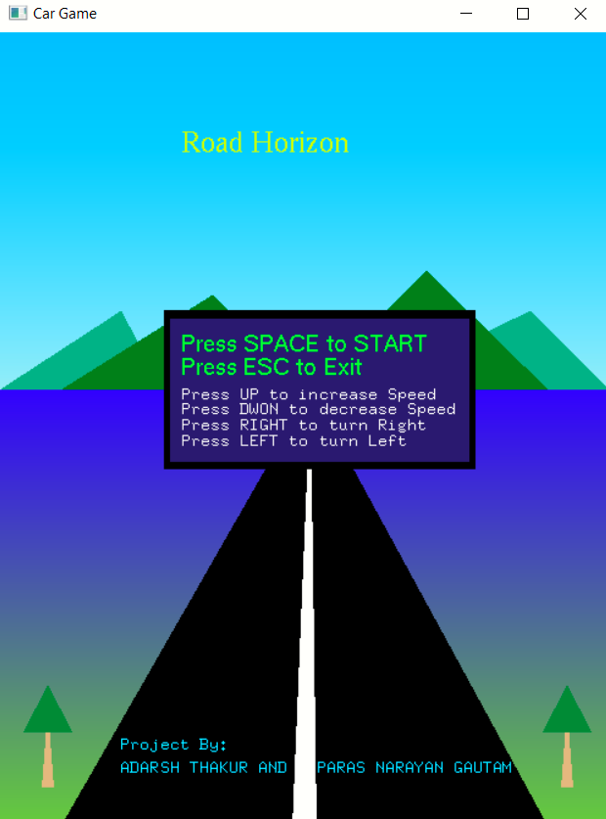
Working:-
STEP 1: Run the game then the user will redirect to front page of the game in which user can read the instruction to play.
To start the game user have to press the spacebar and to Exit the game user have to press ESC button.

Slide 7
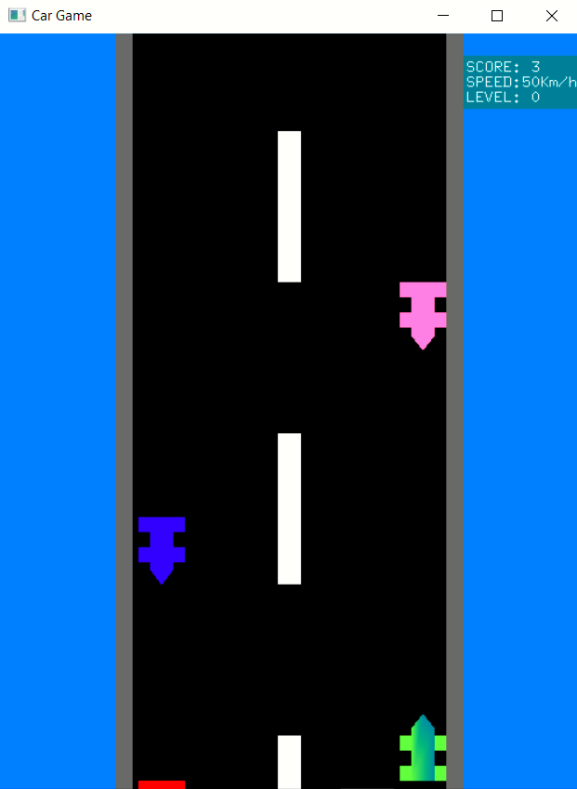
Working:-
STEP 2: After pressing the spacebar user will redirect to the Start game window, Here user can shift its Green car position with the left , right buttons and increase or decrease the speed of obstacles with up and down buttons.

Slide 8

Working:-
STEP 3: On collision with any opposite car the game will over and user will redirect to the front page screen with displaying your previous game score.

Slide 9
THANK YOU

